Slide 1
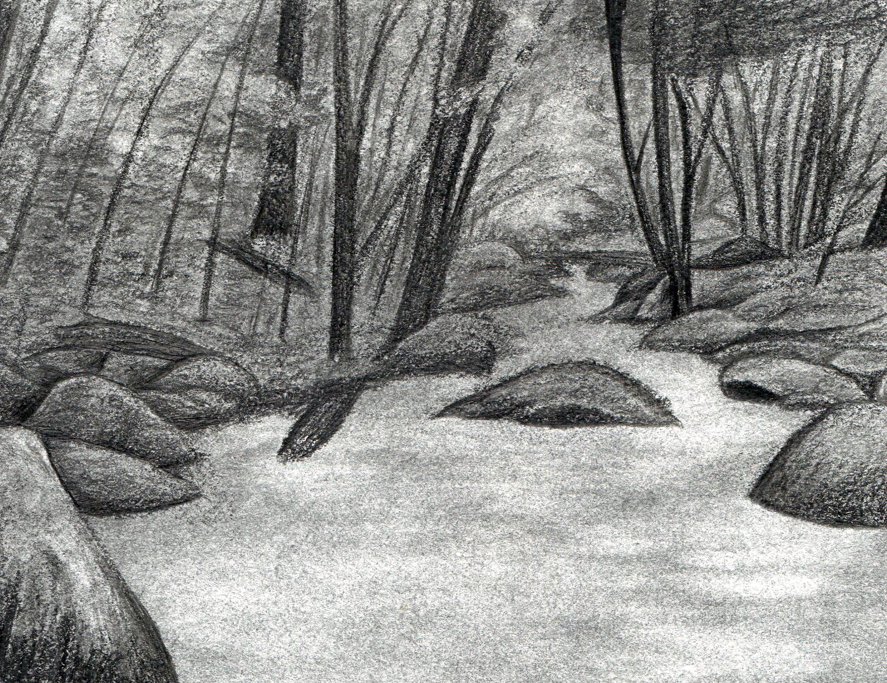
How to Earn Your Prize
We’ve grouped together some of our oldest and newest geocaches for you to find. Before you start, you’ll need to register your username at Geocashing.com and print out a copy of this passport. You only need to find 20 of the 22 geocaches listed here to earn your prize. Once you have 20 passwords go to the website below to fill out your prize form!
Terms and Conditions
Prizes are awarded in the order that they are received, while supplies last. Allow 4-6 weeks for delivery of your prize. You must sign the physical cache logbook of each geocache you find, and log your find on Geocaching.com to be eligible. Additional terms and conditions may apply.
http://arabiaalliance.org/explore/geocaching-adventures/
‘S
Print Your Geocaching Username Here
Past and Present Passages
Passport
Welcome to the
Arabia Mountain National Heritage Area.
We have lots of geocaches for you to find, so get out your trusty GPS and enjoy exploring our miles of meandering nature trails, historic landmarks, and breathtaking scenery!
This program was made possible in part by a grant from the National Park Foundation through the generous support of Coca-Cola, the Coca-Cola Foundation, Disney, and the Scrooby Foundation.

Slide 2
Past and Present Passageways
Geocache Code_________________________ Date_____________ Password________________________________
Geocache Code_________________________ Date_____________ Password________________________________
Geocache Code_________________________ Date_____________ Password________________________________
Geocache Code_________________________ Date_____________ Password________________________________
Geocache Code_________________________ Date_____________ Password________________________________
Geocache Code_________________________ Date_____________ Password________________________________
Geocache Code_________________________ Date_____________ Password________________________________
Geocache Code_________________________ Date_____________ Password________________________________
Geocache Code_________________________ Date_____________ Password________________________________
Geocache Code_________________________ Date_____________ Password________________________________
Geocache Code_________________________ Date_____________ Password________________________________
Geocache Code_________________________ Date_____________ Password________________________________
Geocache Code_________________________ Date_____________ Password________________________________
Geocache Code_________________________ Date_____________ Password________________________________
Geocache Code_________________________ Date_____________ Password________________________________
Geocache Code_________________________ Date_____________ Password________________________________
Geocache Code_________________________ Date_____________ Password________________________________
Geocache Code_________________________ Date_____________ Password________________________________
Geocache Code_________________________ Date_____________ Password________________________________
Geocache Code_________________________ Date_____________ Password________________________________
Geocache Code_________________________ Date_____________ Password________________________________
Geocache Code_________________________ Date_____________ Password________________________________

